Slide 1
Benchmark Testing
Punam Rani Pal, Weiwei Chen

Slide 2
Systems Chosen
Local MySQL
- Relational database system with client/server architecture, easy to use
- Export/import databases
- Great medium to store data
- Good performance on simple queries
Cloud MySQL
- Take advantages of cloud deployment model
- Easy to set up, convenient to use
- High scalability and performance
BigQuery
- Work well with structured/unstructured data
- Serverless, computing source can be spun up on demand
- Scan Terabytes of data in seconds and Petabytes of data in minutes
- Load data from Google Cloud Storage, or Google Cloud DataStore, or stream into BigQuery storage

Slide 3
BenchMark Goals
Comparing three different systems ( Local MySQL, Cloud MySQL and BigQuery)
Performance Measurements (Based on Duration of execution):
- Full table scan
- Insert data into the existing table
- Delete an existing data
- Using Indices
- Joins (Indices/Non-Indices)

Slide 4
Experiment 1 (Full table Scan)
Table Size: 880,000 Tuples
Goal: Measure the performance of scanning full table in three different systems.
Result:

Slide 5
Discussion of Experiment 1
The results of our first query1 (full table scan) shows that the Cloud MySQl has performed better than the other two system which was quite faster and took much less time.
Bigquery has performed better than the Local MySQL may be the distribution of the table(880.000) tuples was better than the MySQL. Because of the large size of the table Local MySQL has taken more time in fetching the data from the disk.
Cloud MySQL proved faster because it uses the benefits of both cloud deployment and MySQL privileges and thus runs faster.
Our expectation was that cloud mysql will perform better, second would be local sql and then Bigquery but the results are a little different.

Slide 6
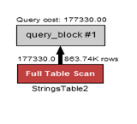
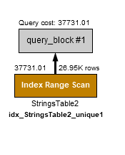
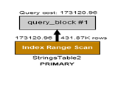
Experiment 2
Performance measures on different selectivity (with/without indices)
Query:
Find all the tuples with even number of unique1 which is less than 2000 (with/without indices) - Selectivity 10%
SELECT * From TENKTUP1 WHERE unique1 < 2000 AND unique1 % 2 = 0;

Slide 7
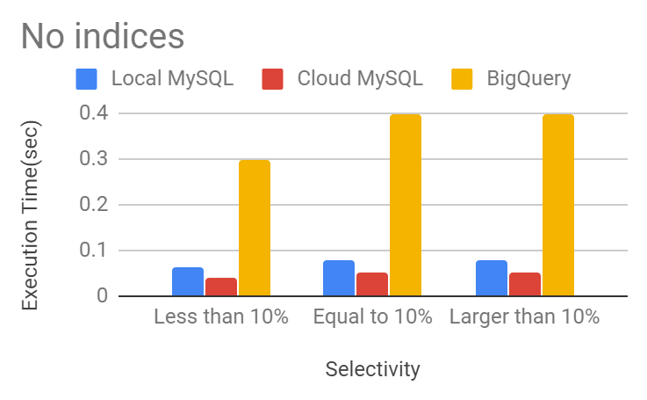
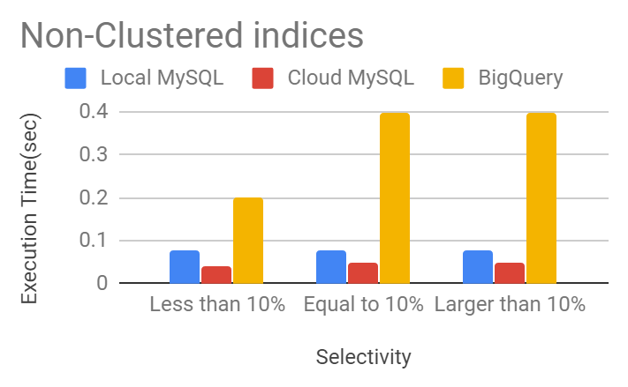
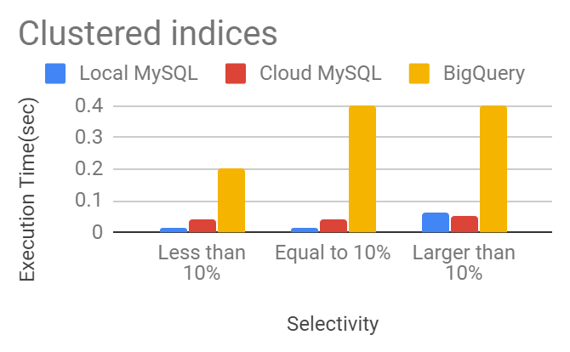
Results for The Experiment
* No indices, full scan
Selectivity | Local MySQL | Cloud MySQL | BigQuery
Less than 10% | 0.063 | 0.04 | 0.3
Equal to 10% | 0.078 | 0.05 | 0.4
Larger than 10% | 0.079 | 0.05 | 0.4
* Non-clustered indices, index range scan
Selectivity | Local MySQL | Cloud MySQL | BigQuery
Less than 10% | 0.079 | 0.04 | 0.2
Equal to 10% | 0.078 | 0.05 | 0.4
Larger than 10% | 0.078 | 0.05 | 0.4
* Clustered indices, index range scan
Selectivity | Local MySQL | Cloud MySQL | BigQuery
Less than 10% | 0.014 | 0.04 | 0.2
Equal to 10% | 0.015 | 0.04 | 0.4
Larger than 10% | 0.062 | 0.05 | 0.4

Slide 8
Modification In Experiment 2
Our experiment 2 results were almost similar and it was hard to distinguish three systems performance.
The values are quite close which simply shows the overhead of the system interface and the actual time for executing the query is ever small than that.
To get more details out of the performance we designed big tables with 100,000 of rows. Initially we were using tables with the maximum size of 10,000.
We performed the experiment with a very large table and record their performance on the next slide.

Slide 9
New Improved Experiment
Query: Large table created with table size 880000 rows (Eight hundred Eighty thousand rows)
No index:
SELECT count(*) From BENCHMARK_PRO.StringsTable2 where unique1 <= 152000;
SELECT * From BENCHMARK_PRO.StringsTable2 where unique1 <= 874185 ;

Slide 10
New Improved Experiment(Continued)
With primary key(Clustered index):
SELECT * From BENCHMARK_PRO.StringsTable2 where unique2 <= 10000;
SELECT * From BENCHMARK_PRO.StringsTable2 where unique2 <= 87500 ;
SELECT * From BENCHMARK_PRO.StringsTable2 where unique2 <= 509308 ;
With secondary index(Non-clustered index):
Use the similar queries with above ones except that changing predicate unique2 to unique1

Slide 11
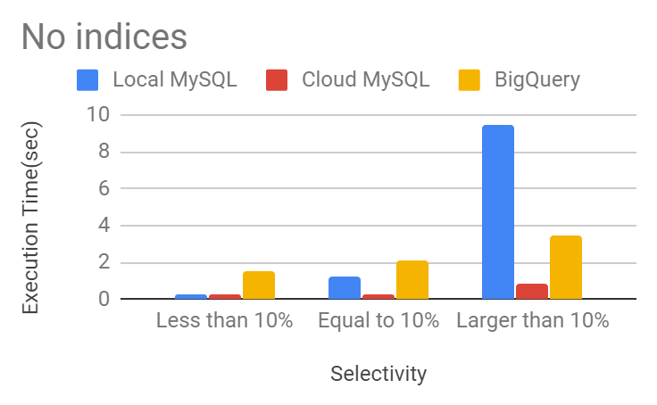
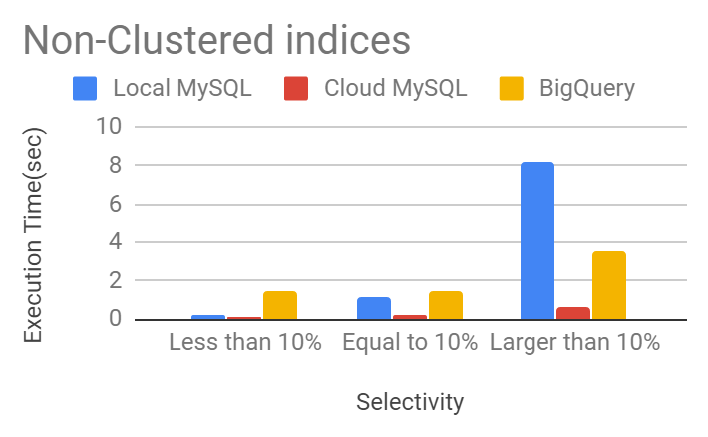
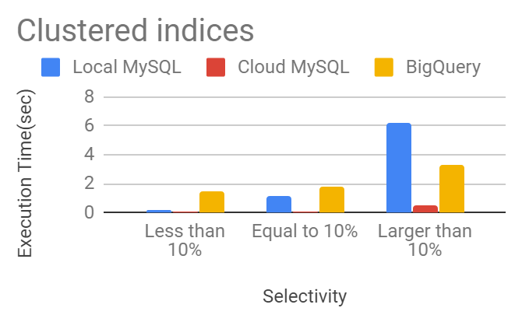
New Improved Results
* No indices, full scan
Selectivity | Local MySQL | Cloud MySQL | BigQuery
Less than 10% | 0.22 | 0.23 | 1.5
Equal to 10% | 1.2 | 0.25 | 2.1
Larger than 10% | 9.5 | 0.84 | 3.5
* Non-clustered indices, index range scan
Selectivity | Local MySQL | Cloud MySQL | BigQuery
Less than 10% | 0.21 | 0.11 | 1.5
Equal to 10% | 1.1 | 0.25 | 1.5
Larger than 10% | 8.2 | 0.67 | 3.5
* Clustered indices, index range scan
Selectivity | Local MySQL | Cloud MySQL | BigQuery
Less than 10% | 0.18 | 0.05 | 1.5
Equal to 10% | 1.1 | 0.1 | 1.8
Larger than 10% | 6.2 | 0.5 | 3.3

Slide 12
Discussion of Experiment 2
From the result of experiment 2 we can see that with no indices the bigquery took more time than the other two systems
Cloud mysql performed better than the other two systems.
With index (Primary Key) bigquery performed same as with no indices. Since, primary key is the clustered index and the queries with different selectivity performed with slightly better than no index in cloud and local msql.
Cloud mysql used clustered index to give better performance.
Our expectation for the experiment two was that with indices mysql will perform better than bigquery and Cloud will perform better than local msql. When using nonclustered the system will not perform better than clustered index.
But our results are different for clustered and non clustered. Both have performed almost similar. May be a table larger than we used may result in some clear distinction in the results.

Slide 13
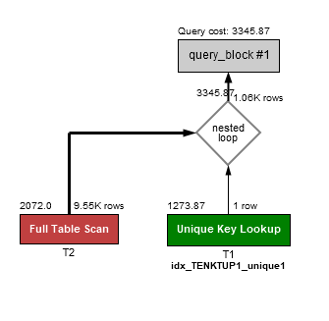
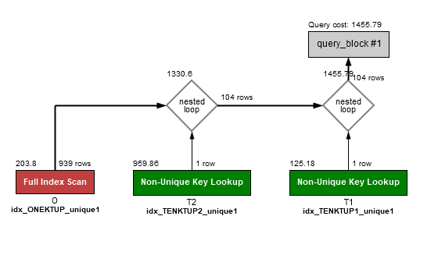
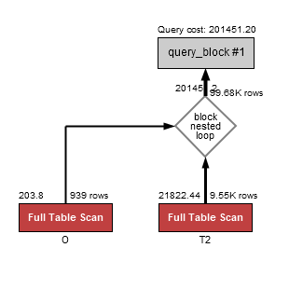
Experiment 3
Performance measures on Join
Example Query:
Find all the stringu1's that has ‘W’ in all the three relations. (with/without Indices)
SELECT T2.stringu1
FROM TENKTUP2 as T2, TENKTUP1 as T1, ONEKTUP as O
WHERE T2.stringu1 = T1.stringu1 AND T2.stringu1= O.stringu1 AND T2.stringu1 like '%W%'

Slide 14
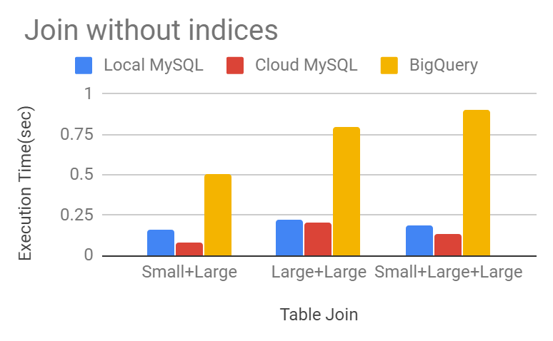
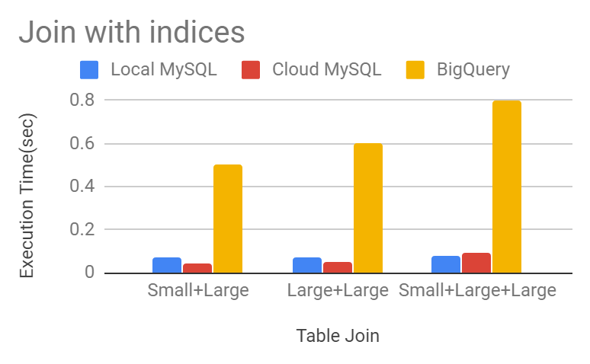
Results for The Experiment 3
* Join without indices
Table Join | Local MySQL | Cloud MySQL | BigQuery
Small+Large | 0.16 | 0.08 | 0.5
Large+Large | 0.219 | 0.20 | 0.8
Small+Large+Large | 0.23 | 0.19 | 0.9
* Join with indices
Table Join | Local MySQL | Cloud MySQL | BigQuery
Small+Large | 0.073 | 0.04 | 0.5
Large+Large | 0.074 | 0.05 | 0.6
Small+Large+Large | 0.16 | 0.04 | 0.8

Slide 15
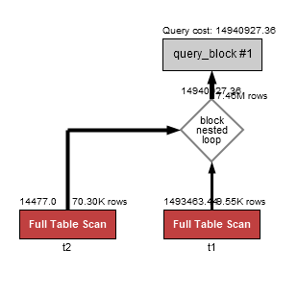
New Improved Experiment
Example query:
SELECT T2.stringu1
FROM TENKTUP2 as T2, TENKTUP1 as T1, ONEKTUP as O
WHERE T2.stringu1 = T1.stringu1 AND T2.stringu1= O.stringu1 AND T2.stringu1 like '%W%'

Slide 16
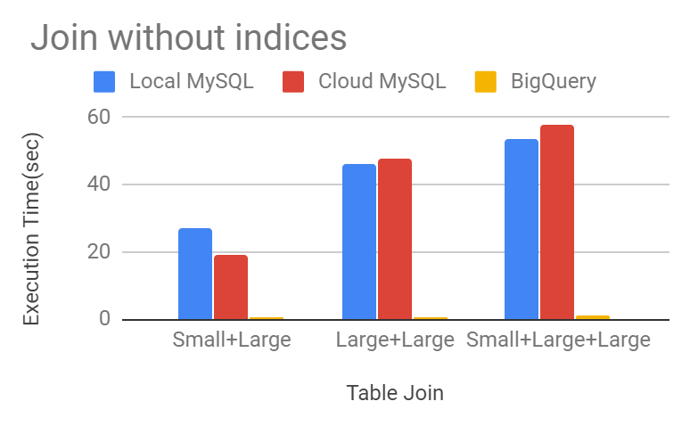
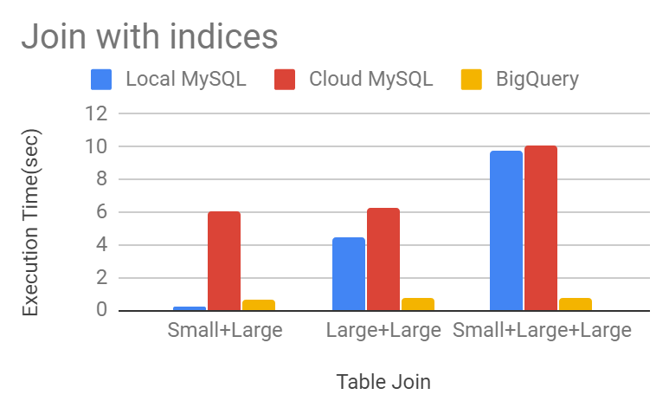
New Improved Results
* Join without indices
Table Join | Local MySQL | Cloud MySQL | BigQuery
Small+Large | 27.1 | 19 | 0.6
Large+Large | 46.3 | 47.6 | 0.8
Small+Large+Large | 53.4 | 58 | 0.9
* Join with indices
Table Join | Local MySQL | Cloud MySQL | BigQuery
Small+Large | 0.165 | 6.1 | 0.6
Large+Large | 4.5 | 6.3 | 0.8
Small+Large+Large | 9.8 | 10.1 | 0.8

Slide 17
Discussion of Experiment 3
Our earlier experiment is performed with smaller tables l and hence the results were too close to predict any difference between systems. We performed the experiment again with tables having more number of tuples.
Bigquery has performed better with joins the reason could be that bigquery picks strategy depends on the query needs.
Mysql used nested loop join and it results to be the most expensive join with the large table which we can see in this case. Both local and cloud mysql have taken a lot of time than bigquery.
Nested loop join should be kept as a last option and mysql seemed to picked it every time the queries run.

Slide 18
Experiment 4 ( Insertion)
Goal: To measure the performance of a single insertion in three different systems
Insert Query:
INSERT INTO ONEKTUP (unique1,unique2,two,four,ten,twenty,onePercent,tenPercent,twentyPercent,fifty,unique3,evenOnePercent,oddOnePercent,stringu1, stringu2, stringu4)
VALUES (1001, 1001, 0,0,0,0,0,0,0,0,0,0,0,'WXQRXXXXXX", 'ADEXXXXXXX', 'DERXXX');

Slide 19
Discussion of Experiment 4
Results from the experiment shows that a single insertion performance is a little slower in BigQuery, The reason might be the architecture of cloud deployment which stores data on different node and since, the insertion happens at the end of the table it search the entire node to get to the end and then insert the new one.
The results match with our expectation where we predict that the insertion in local mysql will take less time than cloud mysql and bigquery.
Cloud mysql again performed as we expected, though the results we got didn’t elaborate the details but we think if we do multiple inserts, the result would be pretty much similar. Cloud has its own overhead on update and insert
Local mysql has a designated memory area which is not as vast as cloud which makes insertion faster and efficient.

Slide 20
Conclusions
In our First experiment, query using indices performed better by using Cloud MySQL than BigQuery as expected.
Smaller selectivity performed better only with using clustered index as per our experiment and we also expected that the performance will be in Decreasing order with the increasing order of selectivity with the use of indices.
In our Second experiment, BigQuery took more time than the other two systems as expected.
Cloud MySQL performed better than Local MySQL as expected because of using nested loop join by the latter.
Both LOCAL MySQL and Cloud MySQL performed more or less equally using Indices on joins

Slide 21
Lessons Learned
BigQuery has a very good cache management system. It takes ‘0’ Second to run the same query again.
Cloud MySQL takes much less time if the same query is executed again and again than it’s first execution.
We noticed that MySQL workbench incur some overheads on the execution time maybe due to its display time and interface requirements which result in more time than MySQL Command line. We chose to use MySQL Workbench because it is user friendly.
Insert a new record on Local MySQL is faster than the other two systems
MySQL does have a non-clustered index command.
If a relation has a primary key it always takes it as a clustered index in MySQL if there are no other indices created.

Slide 22
Thank you!

